Slide 1
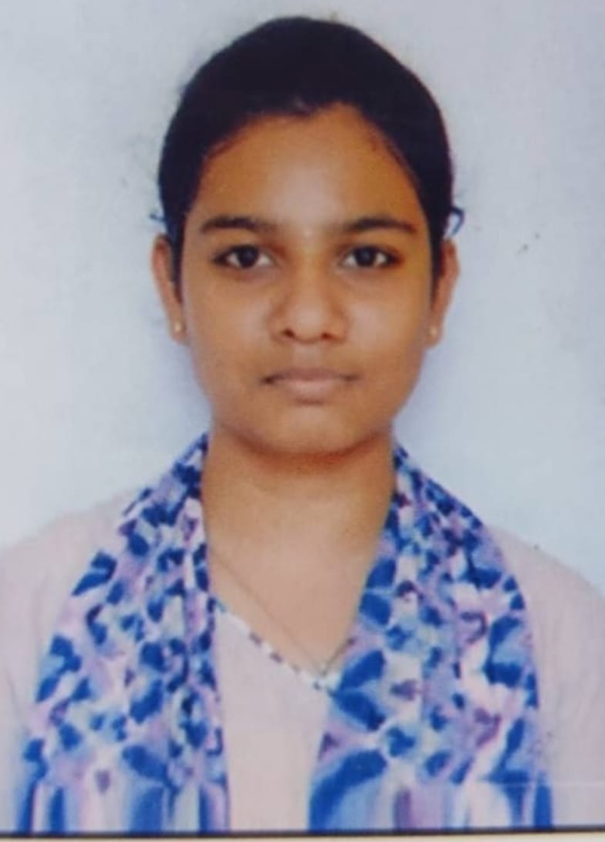
STUDENT DETAILS
INTERN
NAME: HITHOSHINI NAGIREDDY
SKILL BUILD EMAIL ID:hithoshininagireddy03@gmail.com
COLLEGE NAME: N.B.K.R.I.S.T
COLLEGE STATE: ANDHRA PRADESH
INTERNSHIP DOMINE: FRONTEND DEVELOPMENT
INTERNSHIP DURATION: JUNE 6 TO JULY

Slide 2
PORTFOLIO
A portfolio refers to a collection of projects, programs, and other initiatives that are managed together to achieve
specific strategic objectives. It serves as a central management framework for aligning and prioritizing
investments, resources, and efforts across a range of related endeavors.
The purpose of a portfolio is to optimize the allocation of resources and maximize the value delivered to the
organization. It involves strategically selecting, prioritizing, and managing a set of projects and programs that
collectively contribute to the organization's goals and objectives.

Slide 3
AGENDA
Project overview
Who are the end users of this project
Your solution and its value of proposition
How did you customize the project and make it your own
Modeling
Results
links

Slide 4
PROJECT OVERVIEW
A portfolio project refers to a specific project that is part of a larger portfolio of projects within an organization. It is a unique initiative with its own objectives, scope, and deliverables, but it is managed within the context of the overall portfolio.
The purpose of a portfolio project is to contribute to the strategic goals and objectives of the organization. It is selected and prioritized based on its potential value, alignment with the organization's strategy, and available resources. A portfolio project is typically chosen because it addresses a specific need or opportunity and is expected to deliver specific outcomes or benefits.
A portfolio project goes through various stages in its lifecycle, including initiation, planning, execution, monitoring, and closure. During the initiation phase, the project is defined, and its objectives, scope, and success criteria are established. The planning phase involves developing a detailed project plan, including tasks, timelines, resources, and budgets.
In the execution phase, the project team carries out the work according to the plan, and progress is monitored and controlled. Finally, in the closure phase, the project is completed, and its outcomes are evaluated.

Slide 5
WHO ARE THE END USERS OF THIS PROJECT?
The end user of a project resume portfolio would typically be a hiring manager, recruiter, or potential employer who is responsible for evaluating and selecting candidates for job positions. The project resume portfolio serves as a comprehensive and concise representation of an individual's skills, qualifications, and experience related to specific projects they have worked on.
The primary purpose of the project resume portfolio is to showcase the individual's project management capabilities, their role and responsibilities within the projects, the outcomes and achievements of the projects, and the skills and competencies they have developed through their project work.
The end user of the project resume portfolio uses it to assess the candidate's suitability for a particular job or project opportunity.
By reviewing the project resume portfolio, the end user can gain insights into the candidate's project management expertise, their ability to deliver results, their problem-solving and decision-making skills, their collaboration and teamwork capabilities, and their overall project management approach. The portfolio may include details such as project descriptions, objectives, scope, methodologies used, project outcomes, key deliverables, and any notable accomplishments or recognition.

Slide 6
YOUR SOLUTION AND ITS VALUE PROPOSITION
The solution and value proposition of a portfolio lies in its ability to effectively communicate and demonstrate an individual's skills, experience, and accomplishments to potential employers or clients. Here are some key aspects of the solution and value proposition of a portfolio:
1. Comprehensive Representation: A portfolio provides a holistic view of an individual's work and capabilities. It showcases their projects, achievements, and skills in a structured and organized manner, allowing employers or clients to easily understand the scope and depth of their expertise.
2. Visual Presentation: A well-designed portfolio visually presents information, making it visually appealing and engaging. It may include images, graphs, charts, and other visual elements that help convey complex information in a clear and concise manner.
3. Showcasing Expertise: A portfolio allows individuals to highlight their specific areas of expertise and demonstrate their competence in various skills. It provides evidence of their ability to handle different types of projects, solve problems, and achieve results.
4. Enhanced Communication: A portfolio serves as a communication tool, enabling individuals to effectively communicate their qualifications and value proposition. It provides a structured framework for discussing past projects, skills, and achievements during interviews or client meetings.
5. Continuous Professional Development: A portfolio encourages individuals to reflect on their professional growth and continuously update their skills and accomplishments. It promotes a mindset of ongoing learning and improvement, as individuals strive to add new projects and experiences to their portfolio.

Slide 7
HOW DID YOU CUSTOMIZE THE PROJECT AND MAKE IT YOUR OWN
1. Add Personal Touch: Customize the project descriptions and narratives to reflect your own experiences and contributions. Describe your role, responsibilities, and the unique value you brought to the project. Share anychallenges you encountered and how you overcame them.
2. Showcase Results and Impact: Emphasize the outcomes and impact of the projects. Highlight the value you delivered to clients or organizations, such as cost savings, revenue growth, process improvements, or customer satisfaction. Use metrics and data whenever possible to quantify the results.
3. Highlight Skills and Technologies: Clearly articulate the skills, tools, and technologies used in each project. Mention any specific programming languages, software, or methodologies that you employed. This helps potential employers or clients understand your technical capabilities.
4. Continuously Update and Improve: Regularly review and update your portfolio with new projects,skills, and accomplishments. As you gain more experience and complete new projects, replace older or less relevant ones with fresh and impactful examples.

Slide 8
MODELLING
When creating a portfolio website, you can utilize various modeling techniques and technologies to enhance its design and functionality. Here are some commonly used techniques and technologies:
1. HTML (Hypertext Markup Language): HTML is the standard markup language for creating the structure and content of web pages. It defines the elements and layout of the website.
2. CSS (Cascading Style Sheets): CSS is used to style and format the appearance of HTML elements on a web page. It allows you to customize colors, fonts, spacing, and other visual aspects of your portfolio website.
3. Logo Designing: Logo designing involves creating a unique and visually appealing symbol or emblem that represents your personal brand or business. Tools like Adobe Illustrator or Canva can be used to design logos with various shapes, colors, and typography.
4. Canvas (HTML5 Canvas): The HTML5 Canvas element provides a drawing surface on which you can dynamically render graphics, animations, and interactive elements. It is often used to create visually engaging features on websites, such as charts, graphs, or interactive visualizations.

Slide 9
RESULTS
The result of a resume portfolio website can vary based on individual preferences, design choices, and the specific content included. However, here are some common elements and potential outcomes of a well-executed resume portfolio website:
1. Professional and Polished Appearance: A resume portfolio website should have a clean and visually appealing design that reflects your personal brand and professionalism. It should create a positive first impression and showcase your skills and expertise.
2. Easy Navigation: The website should have intuitive navigation that allows visitors to easily find the desired information. Clear menus, sections, and links can help users navigate through your resume, portfolio samples, and other relevant content.
3. Comprehensive Resume Information: The website should provide a comprehensive overview of your skills, experience, education, and achievements. It can include sections such as a summary, work history, education, skills, projects, certifications, and any other relevant details.
4. Showcase of Certifications: If applicable, your portfolio website can include a section to showcase your Certificates,, or links to external platforms where your work is featured. This can provide evidence of your capabilities and demonstrate your expertise in specific areas.
5. Contact Information and Call to Action: It's essential to include your contact information, such as email address or a contact form, so potential employers or clients can reach out to you. A clear call to action can encourage visitors to get in touch or explore more of your work.

Slide 10
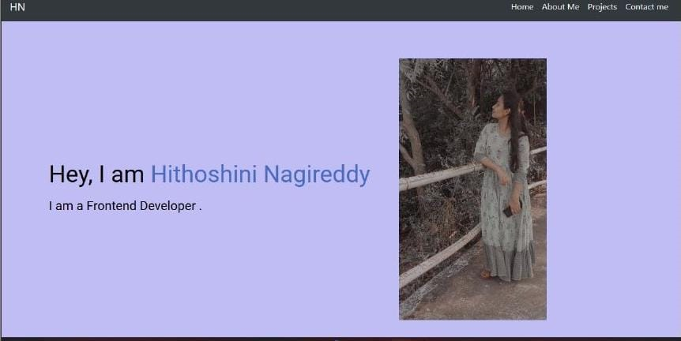

Slide 11
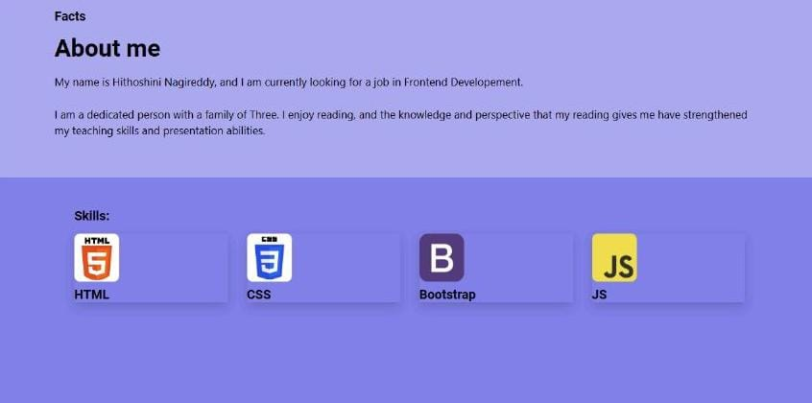

Slide 12
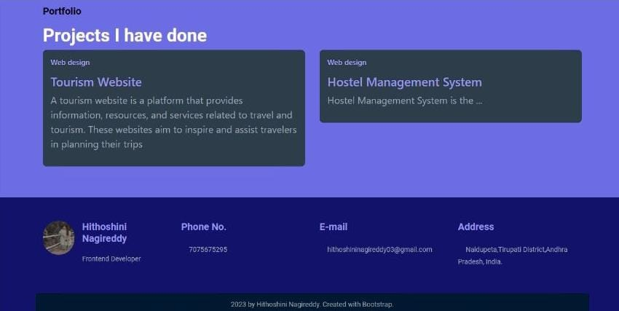

Slide 13
LINKS
1. HTML and CSS Tutorials:
W3Schools HTML Tutorial: https://www.w3schools.com/html/
W3Schools CSS Tutorial: https://www.w3schools.com/css/
IBM skill build platform
2.Logo Design Inspiration and Tools:
Adobe Illustrator: https://www.adobe.com/products/illustrator.html (A professional tool for logo design)
Canva Logo Maker: https://www.canva.com/create/logos/ (An online design tool with logo templates)

